Slide 1

TASK 3

Slide 2
REPORT (TASK 3)
Title: Cross-site scripting
Domain: vulnweb.com
Sub-domain: testasp.vulnweb.com
http://testasp.vulnweb.com website has an endpoint that is vulnerable to an injection vulnerability. The xss vulnerability is present in the search bar of this website. This is a reflected cross site scripting vulnerability as this leads to client-side attack.
According to Portswigger, Cross-site scripting (also known as XSS) is a web security vulnerability that allows an attacker to compromise the interactions that users have with a vulnerable application. It allows an attacker to circumvent the same origin policy, which is designed to segregate different websites from each other and Reflected cross-site scripting (or XSS) arises when an application receives data in an HTTP request and includes that data within the immediate response in an unsafe way.

Slide 3
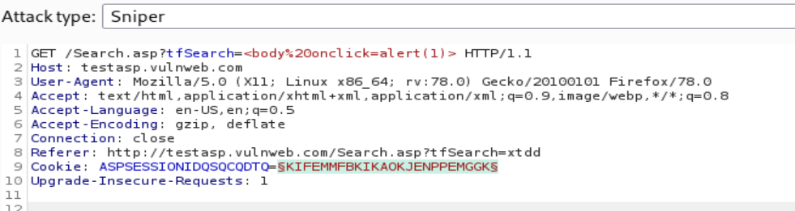
STEPS TO REPRODUCE:
(This can be done by burp suite and many more.)
For this attacker has to:
A) create a payload:
1.create a payload to like:
<body onclick=alert (45)>
2.Insert the payload in the search bar of the
website: testasp.vulnweb.com/Search.asp.
3.Then click to see search posts.
4.Then importantly you need to click again on the search icon or again search posts in the body section.
5.Then you can see that the payload inserted works.
B) Inject this script into the vulnerable parameter(in this website it is the search bar), creating a crafted future GET request that will inject the payload:

Slide 4
IMPACT:
An attacker can often fully compromise a user if they can control a script that is performed in the victim's browser. The attacker can, among other things
1)perform any action that the user can do within the application.
2)Look at any information that the user has access to.
3)Change any information that the user has the ability to change.
4)Start interactions with other app users, including harmful attacks that appear to come from the original victim user.
Mitigation:
Reflected XSS attacks can be prevented and mitigated using a variety of techniques. First and foremost, alertness is the best strategy to avoid XSS scripting from the user's perspective. This means that you should avoid clicking on strange URLs that may contain harmful content. Suspicious links can be identified in the following places:
Unknown senders' emails
The comments area of a website
Unknown people' social media feed
Having stated that, it is ultimately the responsibility of the website operator to protect their users from potential misuse.

Slide 5
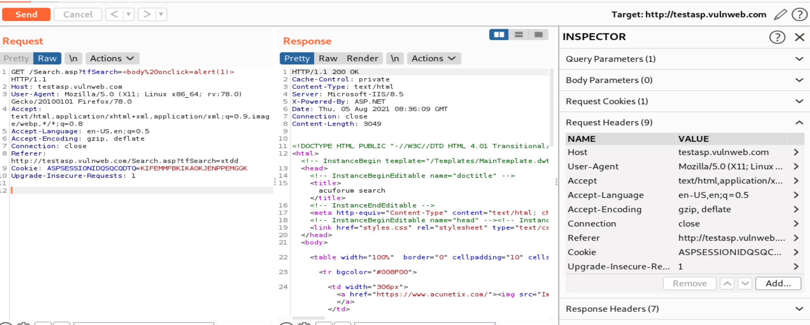
REQUEST POC:

Slide 6
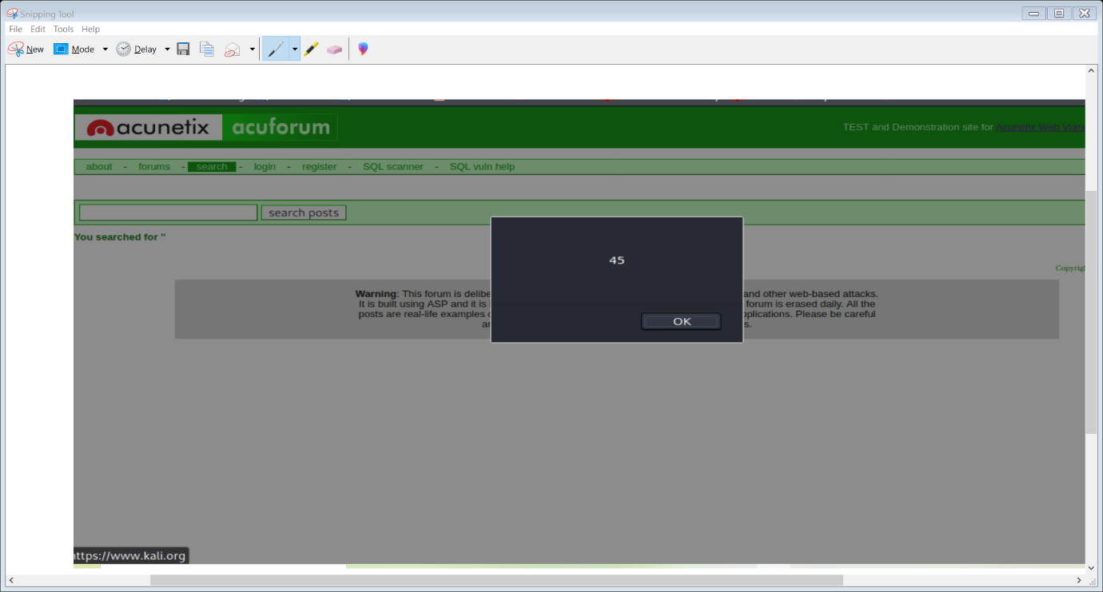
Injection demonstration:

Slide 7
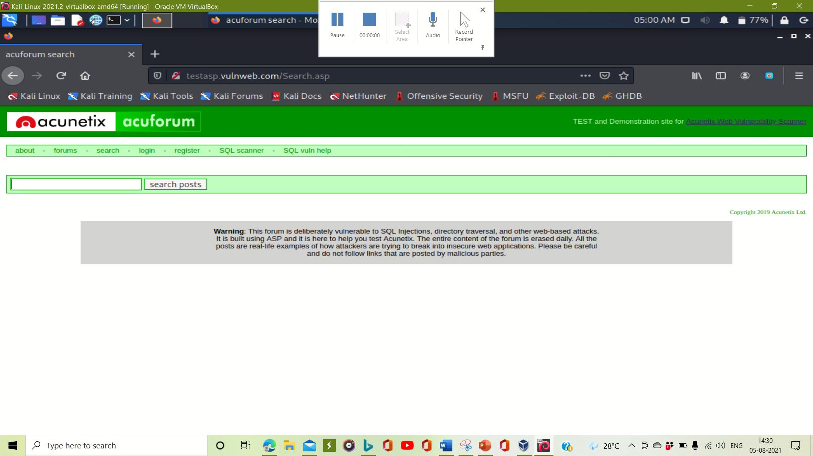
Recording video:

